Slide 1



Supply Chain Inventory - E Grocery
View in Power BI
Last data refresh:
25/6/2026 18:37:05 UTC
Downloaded at:
25/6/2026 19:08:37 UTC

Slide 2
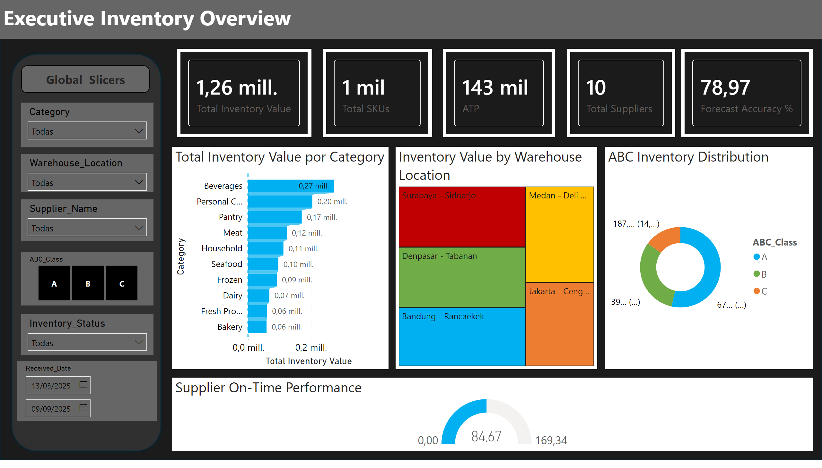
EXECUTIVE DASHBOARD
Notes:
cardVisual
No alt text provided
cardVisual
No alt text provided
cardVisual
No alt text provided
cardVisual
No alt text provided
cardVisual
No alt text provided
barChart
No alt text provided
Inventory Value by Warehouse Location
No alt text provided
ABC Inventory Distribution
No alt text provided
Supplier On-Time Performance
No alt text provided
slicer
No alt text provided
slicer
No alt text provided
slicer
No alt text provided
slicer
No alt text provided
slicer
No alt text provided
slicer
No alt text provided
textbox
No alt text provided
textbox
No alt text provided

Slide 3
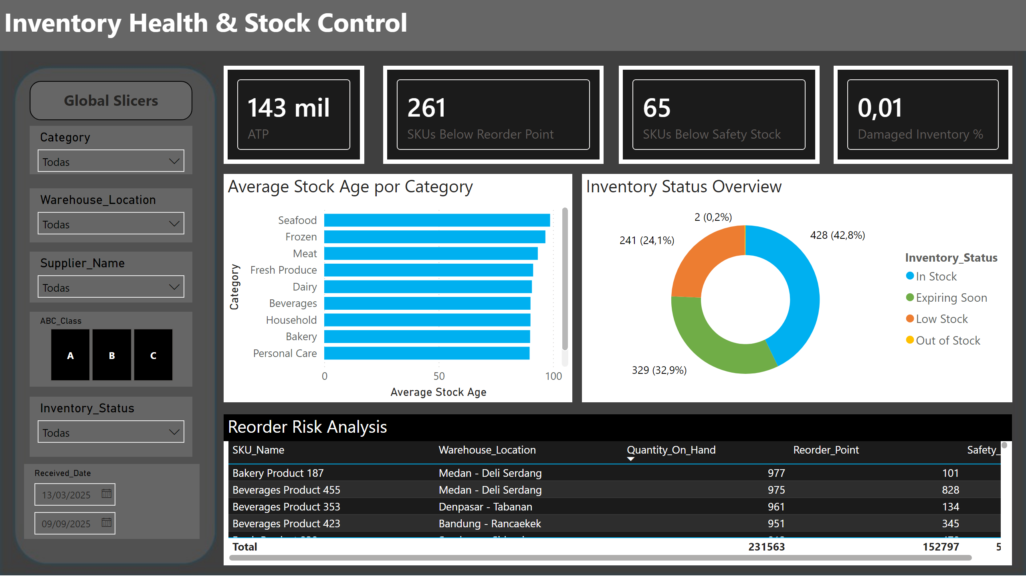
INVENTORY HEALTH
Notes:
cardVisual
No alt text provided
cardVisual
No alt text provided
cardVisual
No alt text provided
cardVisual
No alt text provided
Inventory Status Overview
No alt text provided
barChart
No alt text provided
Reorder Risk Analysis
No alt text provided
slicer
No alt text provided
slicer
No alt text provided
slicer
No alt text provided
slicer
No alt text provided
slicer
No alt text provided
slicer
No alt text provided
textbox
No alt text provided
textbox
No alt text provided

Slide 4
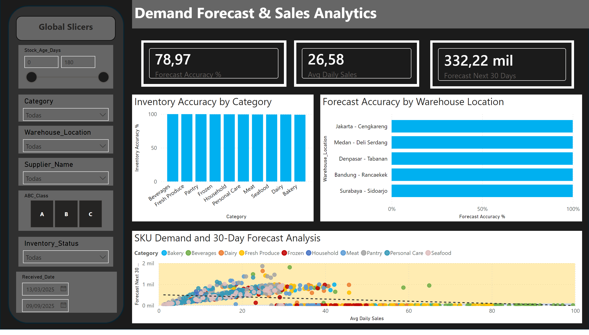
DEMAND & FORECAST
Notes:
cardVisual
No alt text provided
cardVisual
No alt text provided
cardVisual
No alt text provided
Inventory Accuracy by Category
No alt text provided
SKU Demand and 30-Day Forecast Analysis
No alt text provided
Forecast Accuracy by Warehouse Location
No alt text provided
slicer
No alt text provided
slicer
No alt text provided
slicer
No alt text provided
slicer
No alt text provided
slicer
No alt text provided
slicer
No alt text provided
slicer
No alt text provided
textbox
No alt text provided
textbox
No alt text provided

Slide 5
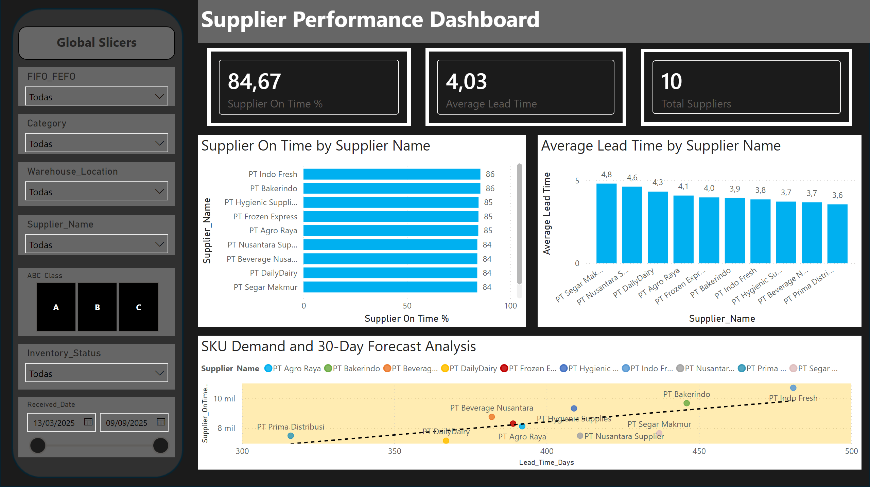
SUPPLIER PERFORMANCE
Notes:
cardVisual
No alt text provided
cardVisual
No alt text provided
cardVisual
No alt text provided
Supplier On Time by Supplier Name
No alt text provided
Average Lead Time by Supplier Name
No alt text provided
SKU Demand and 30-Day Forecast Analysis
No alt text provided
slicer
No alt text provided
slicer
No alt text provided
slicer
No alt text provided
slicer
No alt text provided
slicer
No alt text provided
slicer
No alt text provided
slicer
No alt text provided
textbox
No alt text provided
textbox
No alt text provided

Slide 6
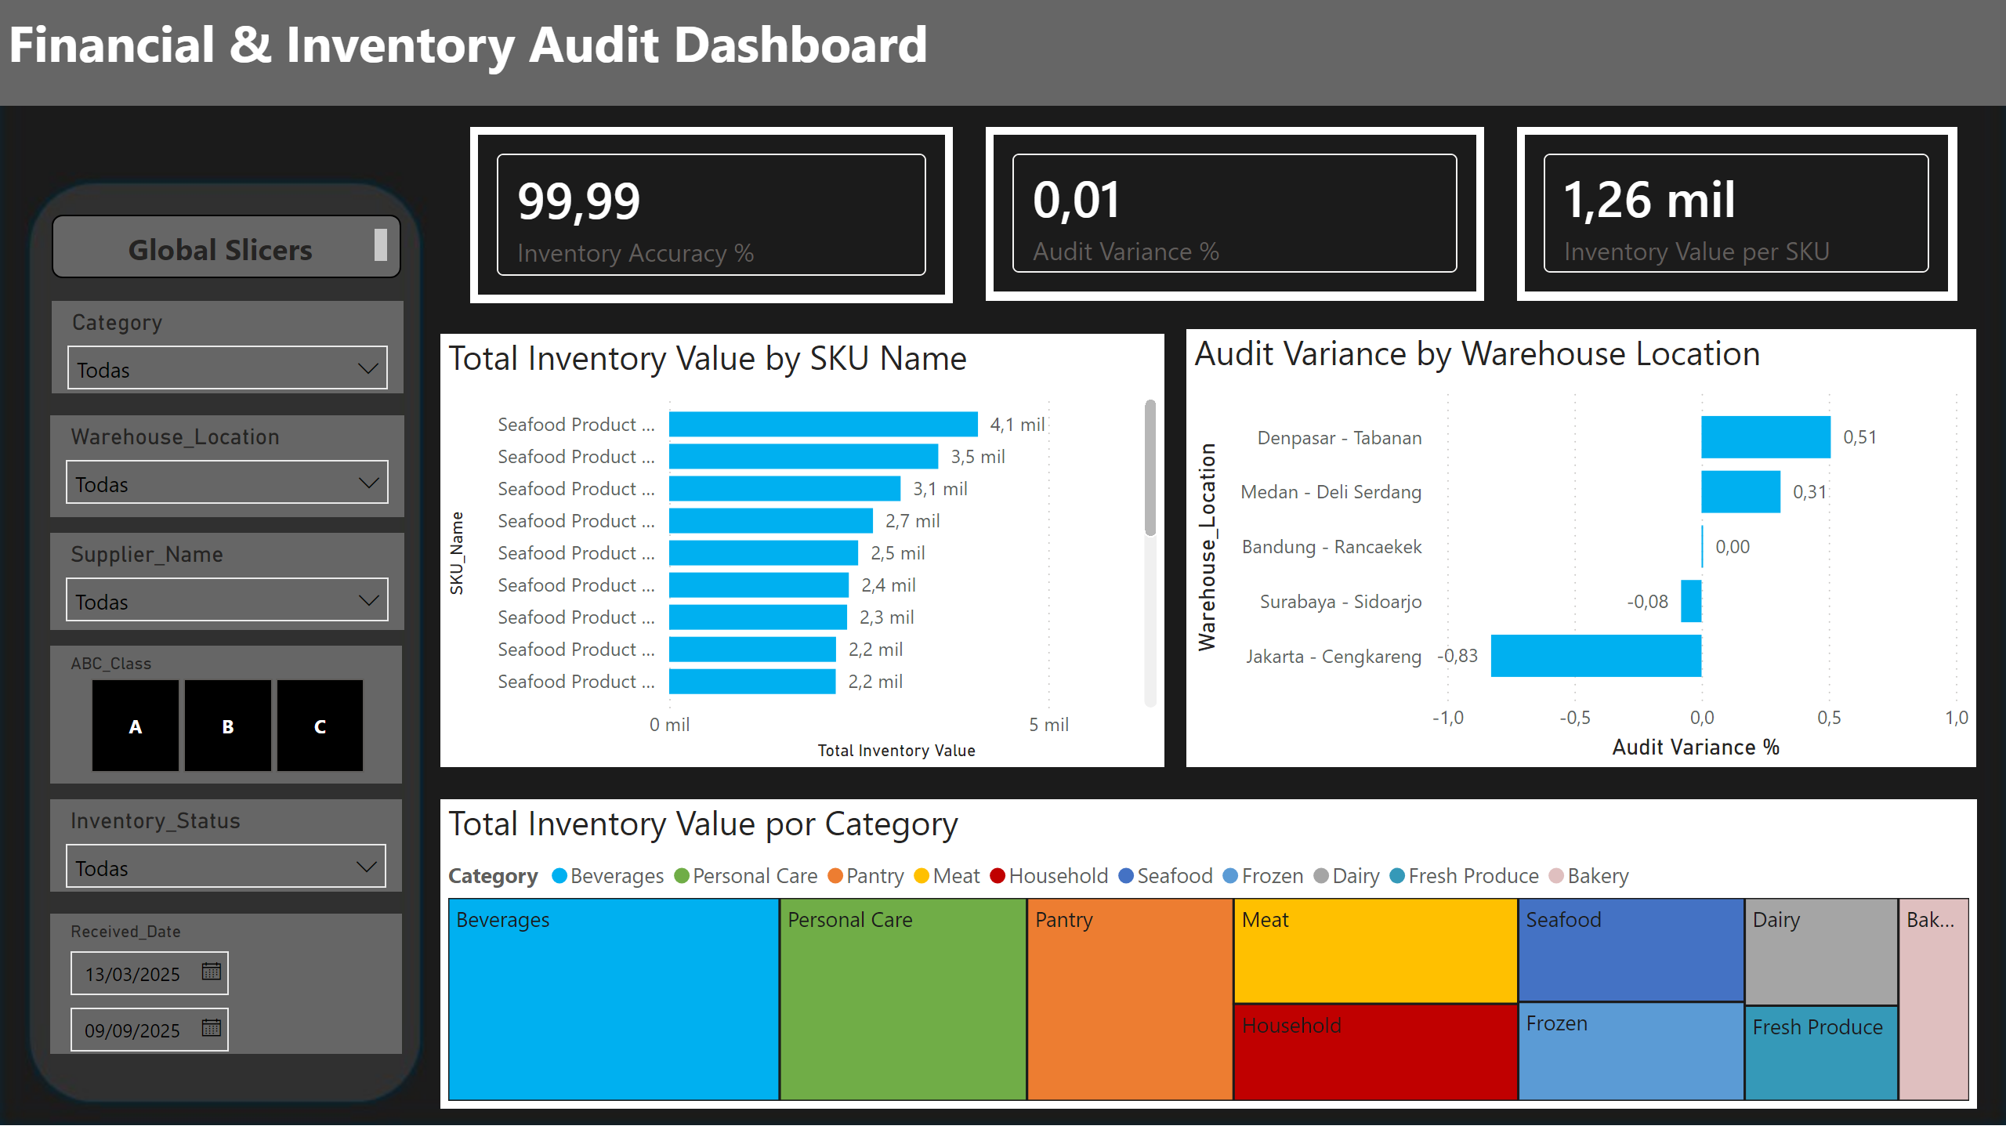
FINANCIAL & AUDIT
Notes:
cardVisual
No alt text provided
cardVisual
No alt text provided
cardVisual
No alt text provided
treemap
No alt text provided
Audit Variance by Warehouse Location
No alt text provided
Total Inventory Value by SKU Name
No alt text provided
slicer
No alt text provided
slicer
No alt text provided
slicer
No alt text provided
slicer
No alt text provided
slicer
No alt text provided
slicer
No alt text provided
textbox
No alt text provided
textbox
No alt text provided

Slide 7

Tooltip
Notes:
cardVisual
No alt text provided

